Slide 1
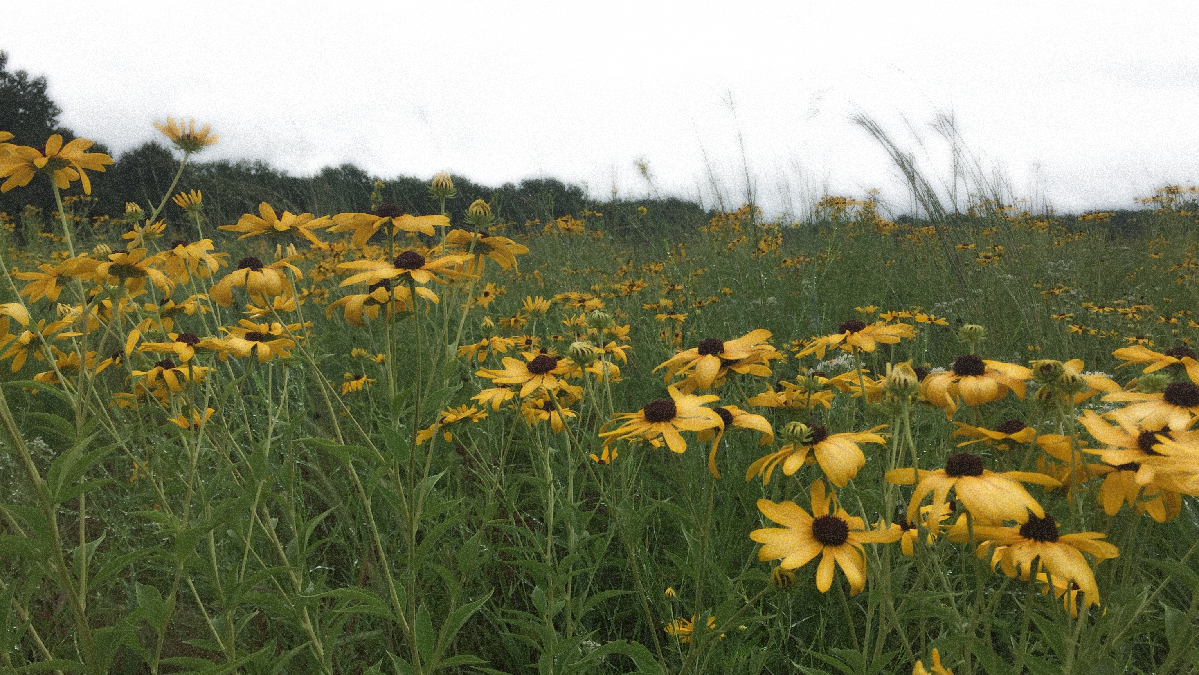
The Soil Health Assessment Protocol and Evaluation (SHAPE)
Kristen Veum
Research Soil Scientist
USDA Agricultural Research Service

Slide 2
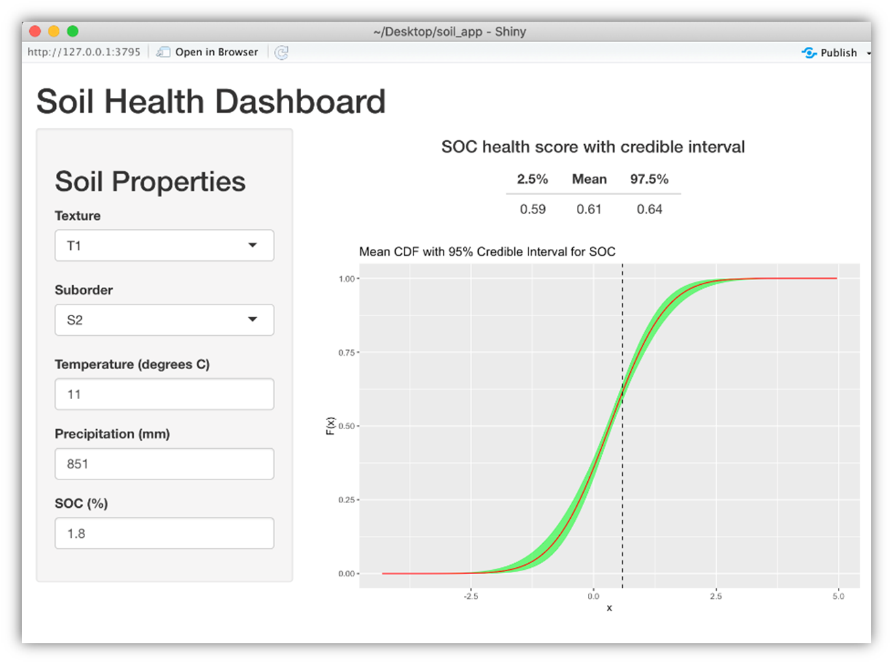
Soil Health Assessment Protocol and Evaluation (SHAPE) SOC Scoring Curves
Collaborators
Kristen Veum, Marcio Nunes, Doug Karlen, & Tom Moorman: ARS/ORISE
Skye Wills & Cathy Seybold: NRCS
Scott Holan & Paul Parker: University of Missouri, Dept. of Statistics
Harold van Es & Joseph Amsili: Cornell University
Notes:
Name is still hotly contested

Slide 3
Indicators selected to represent soil functions or ecosystem services
Soil
Conservation
Environmental Protection
Soil Productivity
Chemical
Physical
Biological
Soil Health

Slide 4
Agricultural Continuum of Soil Health
Higher
Lower
Pasture/Forage/Hay/Biofuel
No-Till + Rotation
Tillage + Monoculture
Cool/Warm-Season CRP
No-Till + Cover Crop + Rotation
Tillage + Rotation
Restored Prairie
Tillage + Manure + Monoculture
Perennial Systems
Annual Cropping Systems
Veum KS, Goyne KW, Kremer RJ, Miles RJ, Sudduth KA (2014) Biological indicators of soil quality and soil organic matter characteristics in an agricultural management continuum. Biogeochemistry
Veum KS, Kremer RJ, Sudduth KA, Kitchen NR, Lerch RN, Baffaut C, Stott DE, Karlen DL, Sadler EJ (2015) Conservation effects on soil quality indicators in the Missouri Salt River Basin. J. Soil Water Conserv.
Notes:
Differences in soil function reflected the positive influence of living roots, reduced soil disturbance, crop diversity, and year-round vegetative cover.
Biomass removal without nutrient replacement (e.g., manure) resulted in significantly lower K.
Mineralizable N was significantly lower following corn (13.2 mg kg⁻¹) than following soybean (36.8 mg kg⁻¹).
But here’s the problem. I made this diagram several years ago based on work I did here in Missouri conducting soil health assessments across a range of production systems. But as you can see, there are no point estimates or values associated with management – just relative

Slide 5
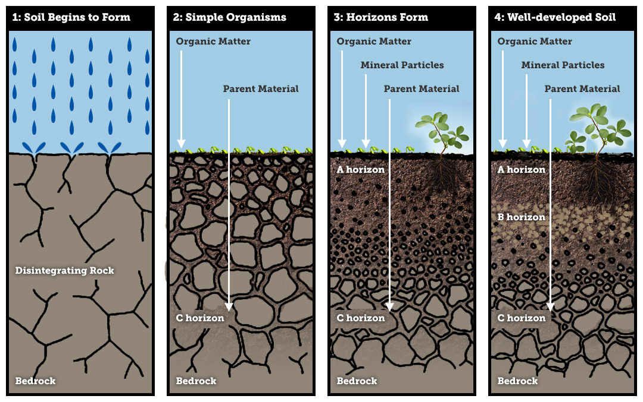
Interpretation of Soil Health Indicators Incorporating Inherent Soil Properties
Vegetation
Climate
Parent Material
Time
Topography/Relief
Management (Human Factor)
Notes:
This what we want to understand and get a handle on, but how can we understand and interpret the role of management unless we account for the other factors first?

Slide 6
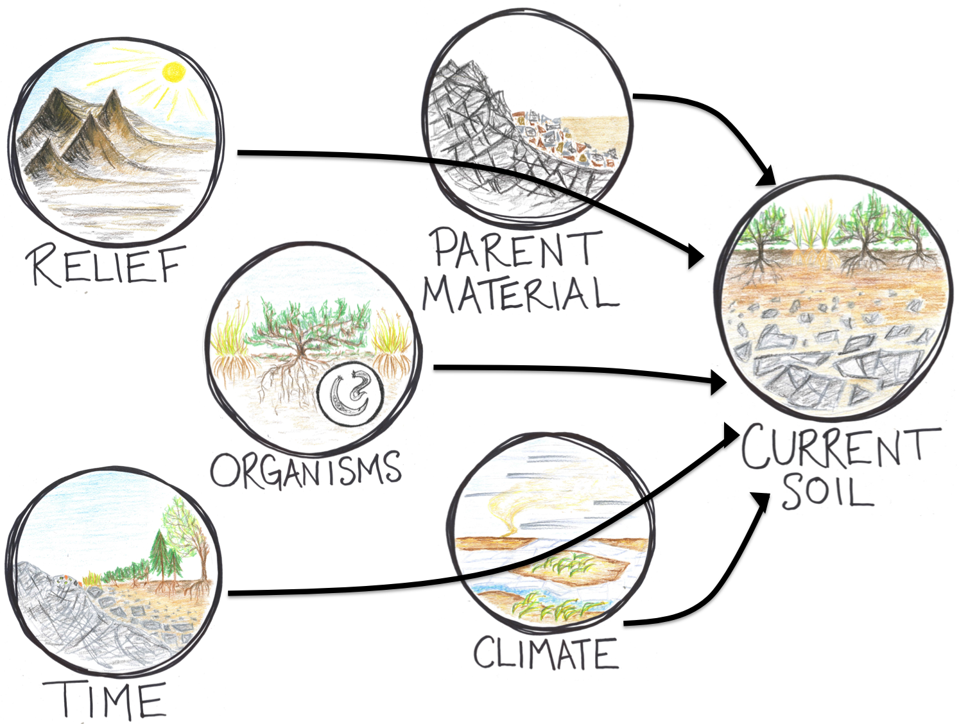
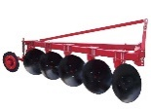



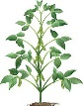
Pedology → Management → Soil Health
SOIL
HEALTH
MANAGEMENT

Slide 7
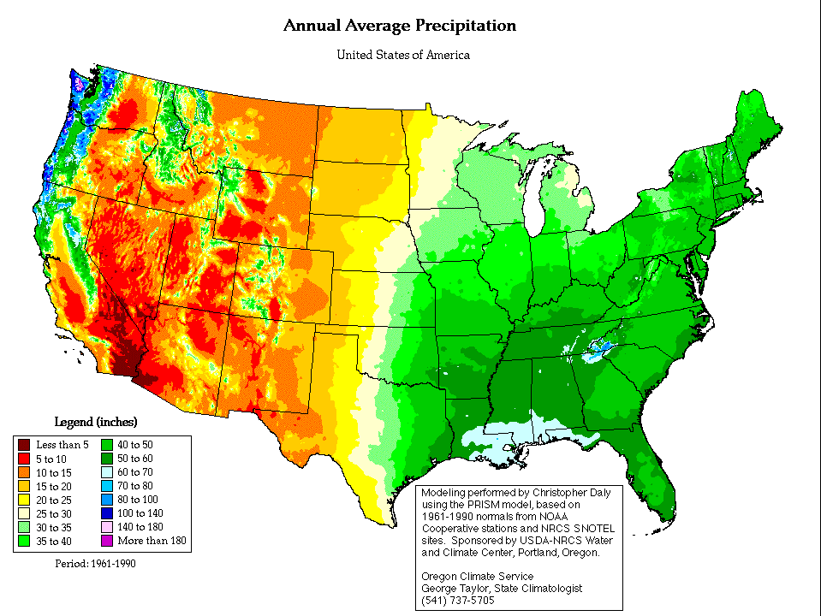
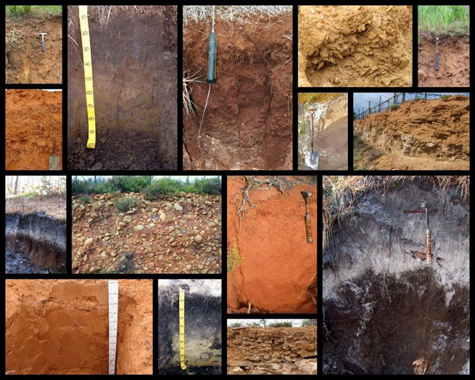
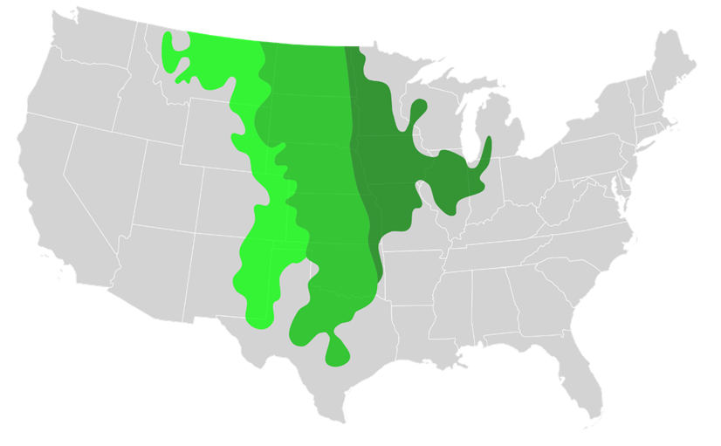
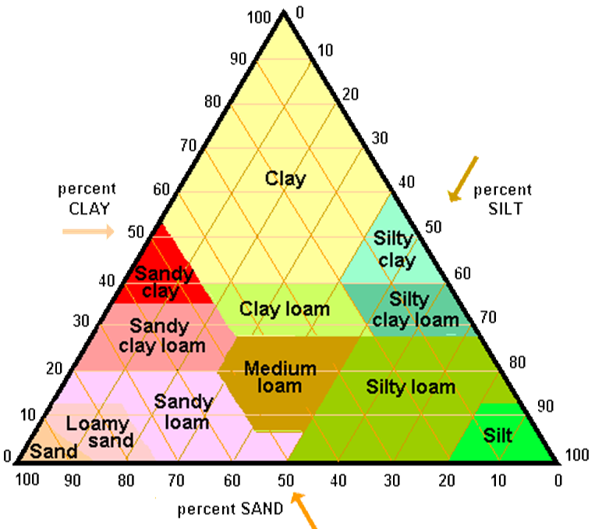
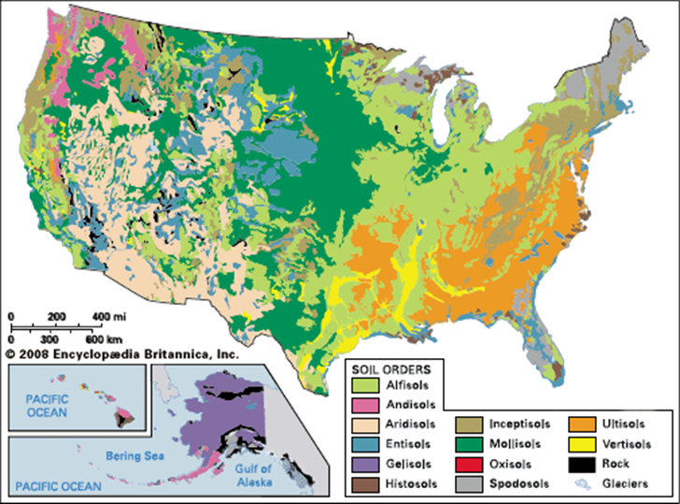
Site Considerations for Soil Health Assessment: Climate, Soil, Vegetation

Slide 8
Applied Agricultural Soil Health Indices Based on Laboratory Indicators
Soil Management Assessment Framework (SMAF)
Uses soil taxonomy and site characteristics for up to 13 indicators
Non-linear scoring curves based on limited data and expert opinion
Comprehensive Assessment of Soil Health (CASH)
Developed for the New York area, recently expanded to the Midwest
Cumulative Normal Distribution (CND), texture
USDA-NRCS Soil Health Division and USDA-ARS initiated a project focused on indicator interpretation and tool development in 2017.
Agreement 67-3A75-17-391: ARS Soil Management Assessment Framework meta-analysis for indicator interpretations and tool development for use by NRCS Conservation Planners
Notes:
Indices may or may not include: soil taxonomy (from SSURGO or lab data), site information (slope, etc.), lab data (soil samples, root samples, or yield), and/or management practices at the field scale.

Slide 9
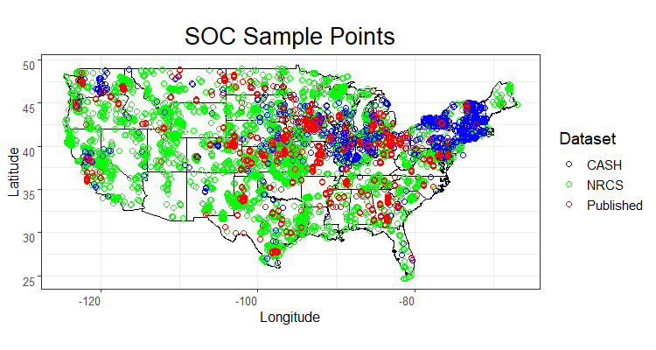
Soil Organic Carbon
Data summary
Observations across the US n = 14680
Published:
From the literature
N = 4129 (456 articles)
Topsoil (≤ 15-cm)
Cornell/CASH:
N = 4183
Topsoil (0- to 15-cm)
Mostly from commercial farms
NRCS/KSSL:
N = 6368
Surface A horizon
Combined:
Several land uses and management
Commercial farms
Experimental plots
Native systems

Slide 10
Potential Climate and Edaphic Factors
Potential inherent factors affecting Soil Organic C within the dataset
Inherent covariates | Unit | Source | Type | Range | N
Climate |  |  |  |  | -
Mean annual precipitation | mm | USGS | Quantitative | 42 – 3671 | -
Mean annual temperature | °C | USGS | Quantitative | -5.6 – 25.3 | -
Potential evapotranspiration | mm/yr | UMTS | Quantitative | 845 – 2539 | -
Wetness index | - | Calculated | Quantitative | 0.03 – 4.16 | -
de Martone aridity index | - | Calculated | Quantitative | 1.6 – 305.5 | -
Soil
Order | - | SSURGO | Categorical | - | 10
Suborder group | - | SSURGO | Categorical | - | 58
Texture class | - | SSURGO | Categorical | - | 12
Drainage class | - | SSURGO | Categorical | - | 8
USGS: United States Geological Survey.
UMTS: University of Montana Terradynamic Simulation Group.
SSURGO: Soil Survey Geographic Database.

Slide 11
Potential Climate and Edaphic Factors
Selected inherent factors to score Soil Organic-C
Inherent covariates | Unit | Source | Type | Range | N
Climate |  |  |  |  | -
Mean annual precipitation | mm | USGS | Quantitative | 42 – 3671 | -
Mean annual temperature | °C | USGS | Quantitative | -5.6 – 25.3 | -
Potential evapotranspiration | mm/yr | UMTS | Quantitative | 845 – 2539 | -
Wetness index | - | Calculated | Quantitative | 0.03 – 4.16 | -
de Martone aridity index | - | Calculated | Quantitative | 1.6 – 305.5 | -
Soil
Order | - | SSURGO | Categorical | - | 10
Suborder group | - | SSURGO | Categorical | - | 58
Texture class | - | SSURGO | Categorical | - | 12
Drainage class | - | SSURGO | Categorical | - | 8
USGS: United States Geological Survey.
UMTS: University of Montana Terradynamic Simulation Group.
SSURGO: Soil Survey Geographic Database.

Slide 12
Statistical Approach and Dataset
Expands on concepts from the Soil Management Assessment Framework (SMAF) and the Comprehensive Assessment of Soil Health (CASH)
Accounts for edaphic and climate factors at the continental scale and assigns scores relative to a defined soil peer group, or cohort.
Peer groups are defined by five soil texture groups and five soil suborder groups, and adjusted for continuous climate variables: mean annual temperature and precipitation
Scoring curves are Bayesian model-based estimates of the conditional cumulative distribution function (CDF) for a given soil peer group.
Produce scores between 0 and 1 (0 to 100%) for measured SOC values that reflect the quantile or position within the conditional CDF along with measures of uncertainty.
Soil organic carbon (SOC) curves developed using a dataset of 14,680 observations from across the U.S.
Data from the literature, Cornell Soil Health Laboratory, and NRCS Kellogg Soil Survey Laboratory

Slide 13
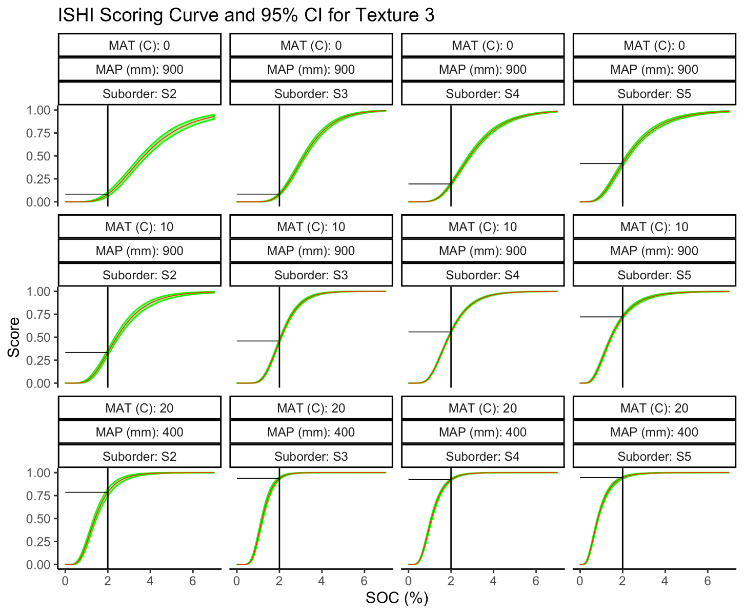
Example SOC scoring curves
Vertical bars = hypothetical SOC of 2.0%; horizontal bars = scores within each peer group.

Slide 14
SHAPE Shiny App
Notes:
Name is still hotly contested

Slide 15
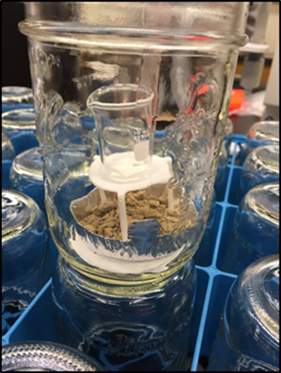
Ongoing and Future Work
Expanding to a wide range of soil properties (soil health indicators)
Active carbon, ACE protein, soil respiration, aggregate stability
Long term - enzymes or molecular data?
Versatility: expanding methods for a given indicator
Conversion factors or modelling separately
Currently developing a spatially explicit version
Soil profile information and land use categories to facilitate more detailed management assessment
Refine the SHAPE Dashboard App: user-friendly
Continuously refine the underlying models as data becomes available

Slide 16
Challenges
Obtaining data to improve spatial coverage and representation
Scale = continental
Identify regional gaps in each indicator dataset to target data collection
Lab to lab variability and hurdles facing labs new to soil health measurements and standardized protocols
Provide decision-based recommendations
Link indicator values back to ecosystem services and establish thresholds or expectations
Value-laden, regionally specific, change over time, tradeoffs (e.g., provisioning and environmental protection)
Value-based interpretation of improved soil health ($, yield, etc.)
Compare production land to native ecosystems? Broad or narrow context?

Slide 17
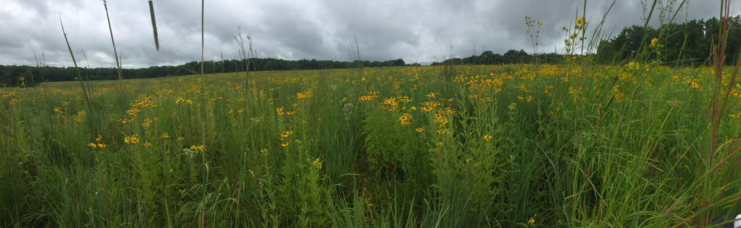
Thank you
The Soil Health Assessment Protocol and Evaluation

